Slide 1


MSc IT+ Projects Tracker
John Hill & Mark McGill
Last Updated April 2023

Slide 2
Project Ideation
To be completed by May 19th 2023

Slide 3
About You This information will help your supervisor to understand your background, skillset and interests Optional – Include a photo of yourself below
Question | Your Response
Is there a name other than your first name as noted with the University that you would prefer to be used by your supervisor in your contact with them? | Jake
Please state your previous degree topic and any other relevant background information you would like your supervisor to know. | My previous topic is “machine production monitoring system”; it is a cooperative study project where I can propose a project with an external company and use it as my capstone project. It’s a data visualisation web application connected to a sensor in the factory where I was responsible for creating backend API and frontend parts. My relevant background is I was a software developer intern for six months. Before my internship, I worked as a React developer.
Please state what previous programming experience (languages, frameworks etc) that you have beyond the current MSc IT+ degree, if any. | Python and JavaScript have been my main tools for two years. For Python, I used it for the backend (Django, Flask) and the EDA process in the Data visualisation product. For JavaScript, I’m comfortable with using React as a frontend.
Please briefly note what future career aspirations you have (e.g. programmer, business analyst, consultant, ...), and what job role you are targeting (e.g. finance, government, technology, academia, ...) after this degree. | I have a strong passion for technology and software development, and my long-term career aspiration is to become a software engineer or programmer. I thoroughly enjoy coding and solving complex problems through software solutions. I’m enjoy learning and trying a new things. Therefore, I’m open minded to any kind of tools, tech and industry types.

Slide 4
Project Topic Ideation Based on John Hill’s Project Ideation video, try to see if you can define a project topic. Your supervisor will then provide feedback on your topic ideas, and prescribe a topic if necessary, by Week 1 of the IT+ projects.
Question | Your Response
For your individual development project, is there any particular platform you want to gain experience developing for (e.g. Web apps, Mobile apps, Desktops apps, Services and APIs, Cloud apps/infrastructure etc.)? | Mobile apps and Web apps
Is there any particular technology or application type you want to focus on (e.g. games, responsive web apps, machine learning etc.) | Database management, API integration and Data visualisation.
Is there a particular subject area that you want your project to work within e.g. business, ecology, sports, travel, entertainment etc. | According to the next question, the subject areas I want my project to work within are Health & Fitness and Personal Finance. However, I’m open-minded about any project related to education.
Do you have a project idea in mind that you'd want to pursue? If so, in a few sentences describe: what the development project would aim to produce why you want to pursue this your initial thoughts on the high level requirements that your project could potentially address | I aim to develop a mobile app that integrates nutrition and financial tracking, enabling users to observe their diet and expenses simultaneously. I'm motivated by the lack of tools merging these important life aspects, and this project will allow me to gain experience in mobile app development, data handling and visualisation. The app would need a user-friendly interface (React Native + Redux), a robust database and server (Postgresql + ExpressJS), API integration for food data and financial tracking, data analysis and visualisation capabilities (D3.js or Chart.js), and stringent data security measures (JWT or Auth0).
Would you be interested in working on a development project with a pre-existing customer within the University (e.g. a School needing a specific web app to be built) | No

Slide 5
Project Topic Ideation Feedback from Supervisor
Your project idea seems well developed, and I especially like the idea of API integration.
So, we have a mobile app for nutrition and finance tracking. Front-end will be React Native and Redux; db/server will be PostgreSQL and ExpressJS; API integration; data analysis and visualisation with D3.js or Chart.js; and security with JWT or Auth0. It will be a good idea to consider why you have selected these elements of the technology stack in comparison with alternatives - this can then be used in the dissertation.
It would be good to have more details of the features/use cases that you will tackle, and also it would be good to think about requirements capture from users (say focus group or survey) who might then be willing to do user acceptance/evaluation at the end.

Slide 6
Project Proposal
To be updated as the topic and scope become clearer from Week 1 onwards

Slide 7
Proposed Project Based on the feedback you received from your supervisor, now refine your understanding of your project topic This should be negotiated and agreed with your supervisor by the start of Week 2 (June 19th 2023) at the latest.
Question | Your Response
What type of application (e.g. Web app, Mobile app, Desktops app, Service/API, Cloud app etc.) are you going to develop? | Mobile application for IOS and Android
What technologies are you going to develop using? (e.g. what framework, stack, programming languages etc). If these are technologies other than what you have gained experience with through the MSc IT+ course, justify this. | Front end: React Native (Expo), NativeBase Back end: ExpressJS and Prisma, Database: Postgresql Others: OpenFoodFactAPI
Describe your project topic and aims, considering: what the development project would aim to produce why you want to pursue this your initial thoughts on the high level requirements that your project could potentially address | What Nutrition, Calories and food expense tracker Why People are mostly focusing on their nutrition needs without concerning their expenses. This application enables users to observe their diet and expenses simultaneously. High level requirement Mobile app with authentication, food & expense logger, and summary dashboard.

Slide 8
Changes to Proposed Project As you progress through the 12 week project, keep a note of any changes to the proposed project topic, aims, technologies used etc. here. This will help your supervisor to understand how the project has evolved and why.
How did the project topic / aims / objectives change? | When did this change occur? (week / date) | Why did you make this change? | Has this been discussed with Supervisor?

Slide 9
URLs / Resources Link to any useful URLs and resources you want to share directly with your supervisor here. This should include a link to your Gitlab repository (once setup by end of Week 1) and the latest working copy of your dissertation (e.g. on Onedrive, Overleaf etc).
Gitlab repository: https://stgit.dcs.gla.ac.uk/msc-project-for-information-technology/2022/it-project-2781155t/2781155t-development-project
Dissertation: https://gla-my.sharepoint.com/:w:/g/personal/2781155t_student_gla_ac_uk/EcCoDjMZYX9DqQGWIYDEdUkBosZMoDfEPX96pOq7kUg1Bg?e=dqY6BK
Remember, both your Gitlab repository and Dissertation should evidence regular, continual progress throughout the 12 weeks (e.g. history of regular commits evidencing you developed your project independently and incrementally). We may refuse to mark any projects that cannot evidence continual progress.

Slide 10
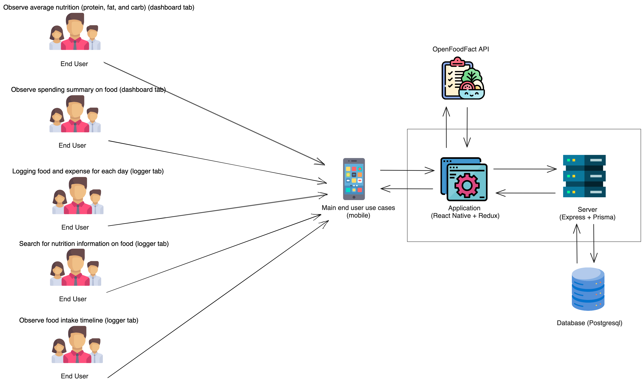
Project Architecture Diagram Add and maintain an architecture diagram to help your supervisor understand your project design and approach

Slide 11
Weekly Progress Tracker To be filled out by the student every week, tracking progress, aims, issues, and planning your agenda for any meetings with your supervisor or GTAs.

Slide 12
Purpose of the Progress Tracker
The progress tracker is here to help you manage your project – to set targets, explore expectations and aims with your supervisor, and organise and document your thoughts and progress along the way
Each week has an associated progress tracker slide that should be filled out week-by-week.
There are also “status update” slides aligned with the mandatory supervisor meetings throughout the project. These should also be filled prior to meeting your supervisor to evidence your progress.
You can modify this template! Adapt it to suit your project needs as you go!
Filling out the Weekly Progress Tracker and Status Update slides is mandatory – If you don’t fill this material out, this will count against your professional conduct grade, and if you can’t evidence you’ve conducted the project independently, we may refuse to mark any submission.

Slide 13
Example
Key Milestones | Status
Project Topic & High Level scope | Complete and written up
Requirements / Analysis | In progress but not written up
Tools, Stack, Dev. Environment
Prototype and Design
Development
System testing
User Evaluations
Dissertation & Video
Key
Meeting Agenda (if scheduled for this week)
Key Points… …that you want to cover… …for this weeks meeting with your supervisor, or with a GTA in the lab.
 | Not Started
 | On track
 | Issues
 | Major issues
 | Completed
Completed Activities This week
Completed Internet search of similar systems Developed personas to drive requirements
Upcoming Activities – Next week
User interface design Database design
Issues, Risks and Concerns
Trying to decide between Django and Flask for the most appropriate Python framework Trying to decide between MySQL and PostgreSQL as the database

Slide 14
Week 1 – Initial Supervisor Meeting
Key Milestones | Status
Project Topic & High Level scope
Requirements / Analysis
Tools, Stack, Dev. Environment
Prototype and Design
Development
System testing
User Evaluations
Dissertation & Video
Key
Meeting Agenda (if scheduled for this week)
Discussing tech stack Discussing about system architecture Planning on MVP
In progress
 | Not Started
 | On track
 | Issues
 | Major issues
 | Completed
In progress
In progress
Not Started
Completed Activities This week
Decided on the tech stack Set up Gitlab
Upcoming Activities – Next week
List requirements of the app Design app pages (site map and wireframe) Create Auth MVP
Not Started
Not Started
Issues, Risks and Concerns
Concerning on issue with React native without expo and M1 machine (solved)
Not Started
Not Started

Slide 15
Week 2
Key Milestones | Status
Project Topic & High Level scope
Requirements / Analysis
Tools, Stack, Dev. Environment
Prototype and Design
Development
System testing
User Evaluations
Dissertation & Video
Key
Meeting Agenda (if scheduled for this week)
In progress
 | Not Started
 | On track
 | Issues
 | Major issues
 | Completed
In progress
Completed
In progress
Completed Activities This week
Create Auth MVP Draft Introduction and Objective
Upcoming Activities – Next week
List requirements of the app Design app pages (site map and wireframe)
Not Started
Not Started
Issues, Risks and Concerns
Most of the requirement are from existing application nutrition tracking) combined with my own additional requirements (food expense tracking), so I am a bit lost on gathering additional requirements from prospect users.
Not Started
Not Started

Slide 16
Week 3/4 Status Update Requirements, Design
I've made significant progress in setting up a React Native environment, navigating through challenges associated with Expo and pure React Native setup. I carefully selected a compatible tech stack, enabling me to develop an authentication prototype for both front-end and back-end systems. In tandem with my technical work, I've reached a critical academic milestone by completing the draft of two chapters on dissertation. Moreover,

Slide 17
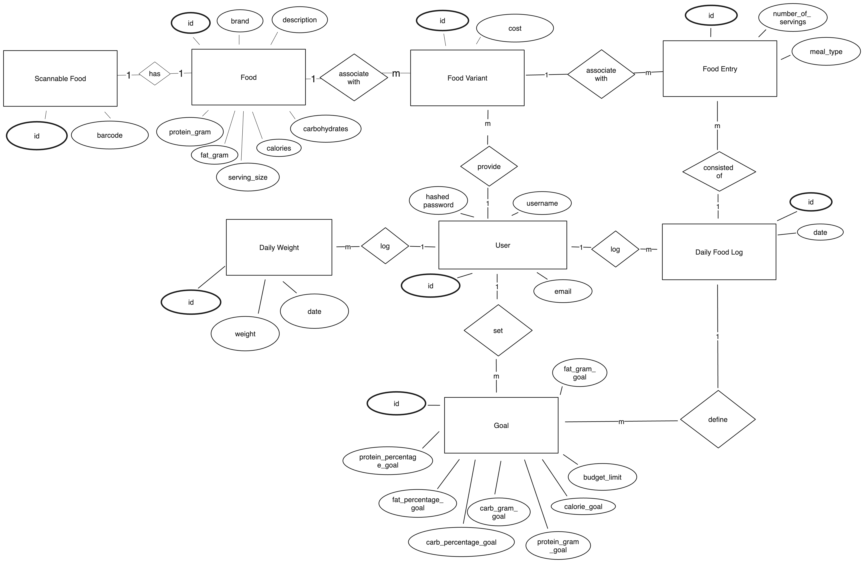
Initial ER-Diagram

Slide 18
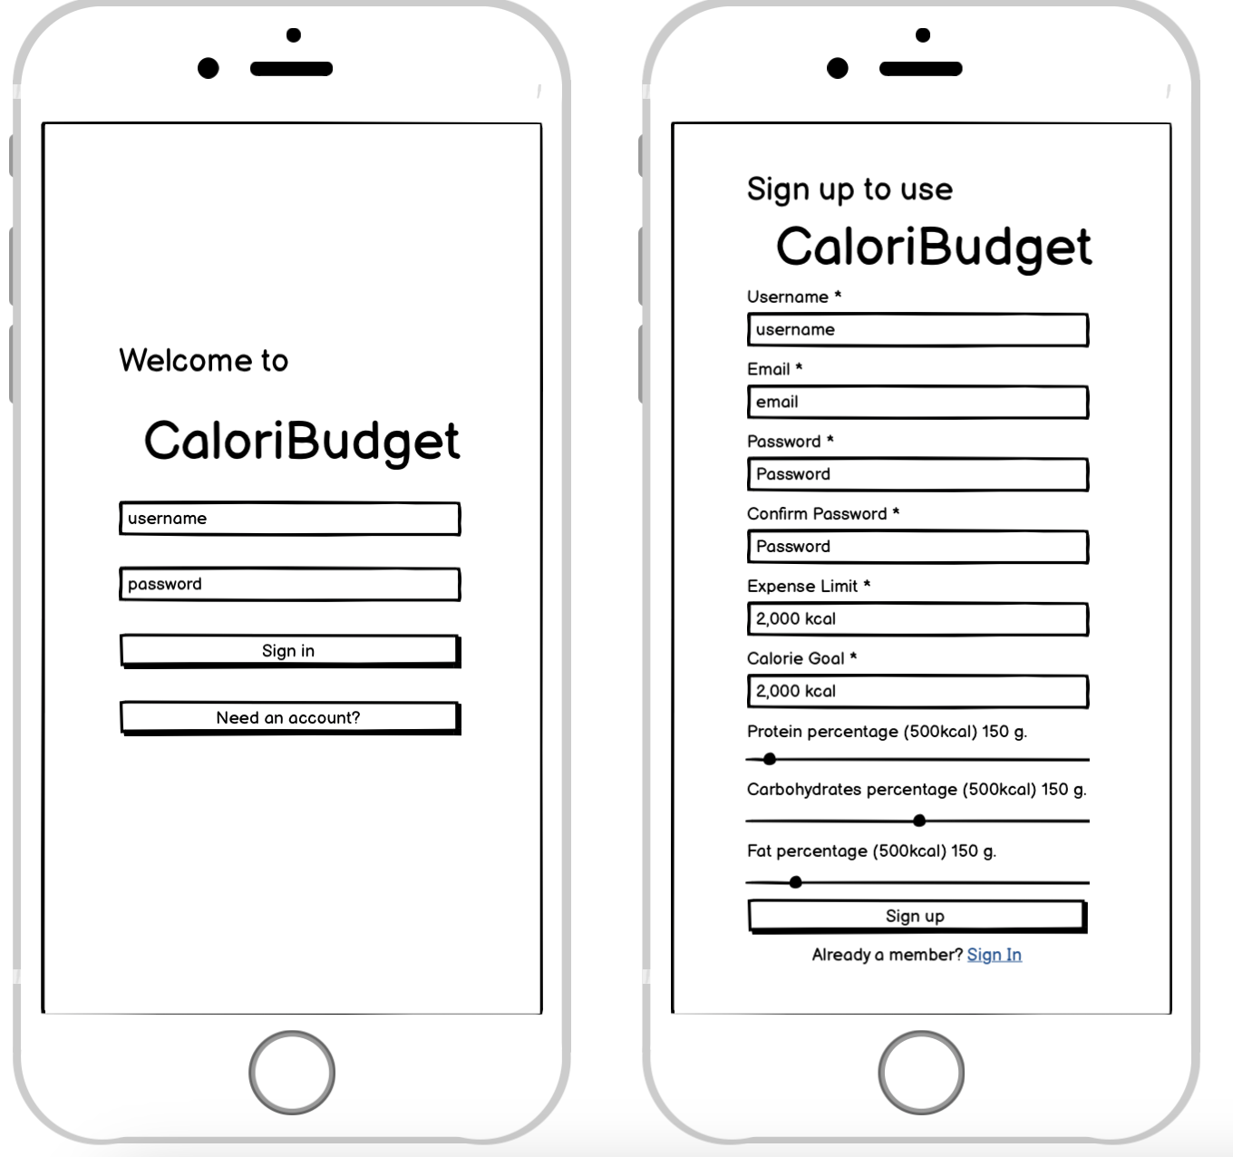
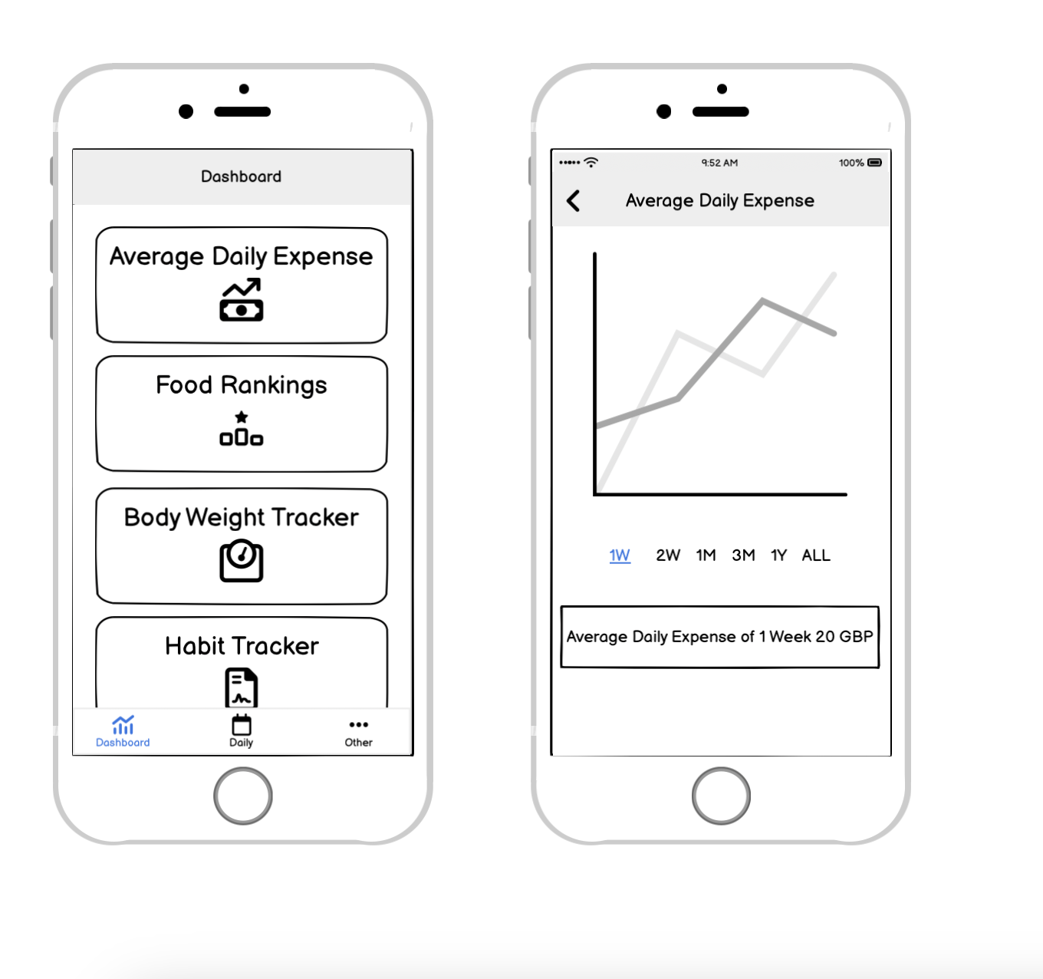
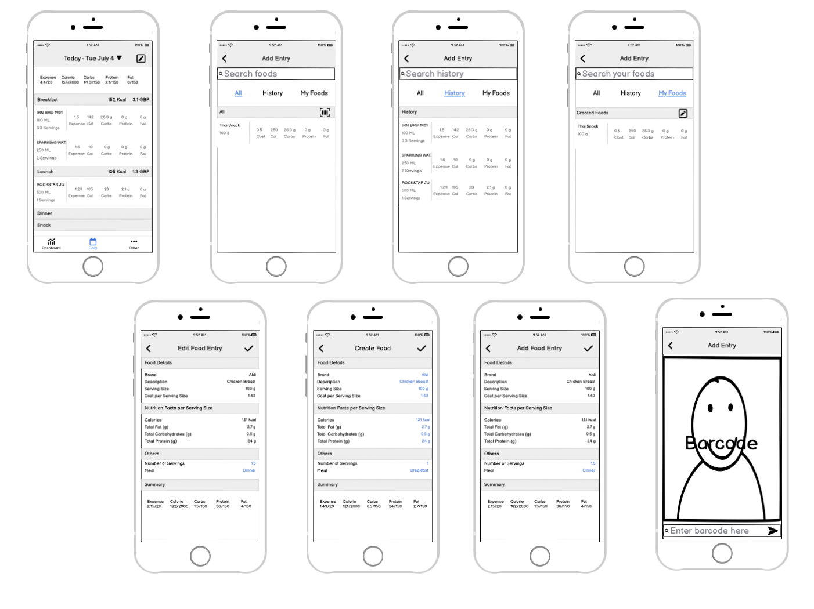
Wireframe-Sample

Slide 19
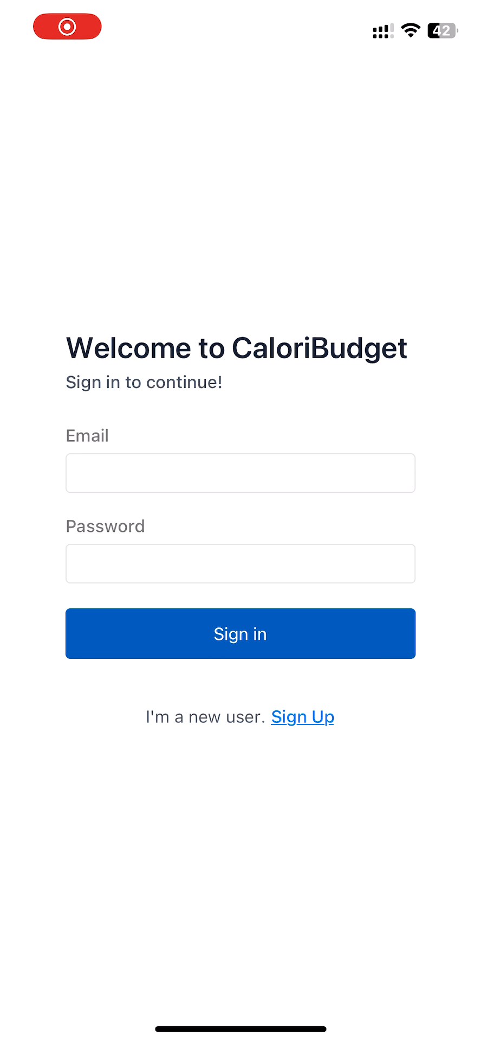
Video of Auth MVP

Slide 20

Week 3
Key Milestones | Status
Project Topic & High Level scope
Requirements / Analysis
Tools, Stack, Dev. Environment
Prototype and Design
Development
System testing
User Evaluations
Dissertation & Video
Key
Meeting Agenda (if scheduled for this week)
Discussing about possible ways to gather requirements from user in an additional study on existing applications and my idea.
Completed
 | Not Started
 | On track
 | Issues
 | Major issues
 | Completed
Completed
Completed Activities This week
Draft existing applications analysis Draft background
Upcoming Activities – Next week
List requirements of the app Design app pages (site map and wireframe) Design Database
Not Started
Not Started
Issues, Risks and Concerns
Not Started

Slide 21
Week 4
Key Milestones | Status
Project Topic & High Level scope
Requirements / Analysis
Tools, Stack, Dev. Environment
Prototype and Design
Development
System testing
User Evaluations
Dissertation & Video
Key
Meeting Agenda (if scheduled for this week)
Discussing about feedback on chapter one, two and ToC
Completed
 | Not Started
 | On track
 | Issues
 | Major issues
 | Completed
Wait for Review
Completed
In progress
Completed Activities This week
Draft requirement & justification List of use cases userflow MoSCoW ER Diagram
Upcoming Activities – Next week
Finish all wireframes Build Logging tab Build Others tab
In progress
Along with dev
Issues, Risks and Concerns
Not Started

Slide 22
Week 5
Key Milestones | Status
Project Topic & High Level scope
Requirements / Analysis
Tools, Stack, Dev. Environment
Prototype and Design
Development
System testing
User Evaluations
Dissertation & Video
Key
Meeting Agenda (if scheduled for this week)
Completed
 | Not Started
 | On track
 | Issues
 | Major issues
 | Completed
Second Draft
Completed
First Draft
Completed Activities This week
Finish all wireframe Build Others tab, and user management
Upcoming Activities – Next week
Build Logging tab Write second draft of ch.2 Write the first draft of ch.3
In progress
Along with dev
Issues, Risks and Concerns
Not Started

Slide 23
Week 6/7 Status Update
From week 5 to week 6, the application allows users to create their food with nutrition and expense information, which can be logged as food entries for each day by the user.
Still, I realised that my RDB design used too many relations between tables, which cause the following causes.
If user edit food information, it will affect the logged entry and and make data inconsistent.
If user A use food created by user B and one day user B edit the food information. This causes data inconsistent as well.
Fortunately, this problem is a design decision, not a technical problem, and if the decision of design has been made within week 6, all of the "Must Have" will be done, and the "Should Have" functionality will be implemented soon.
​

Slide 24
Week 6
Key Milestones | Status
Project Topic & High Level scope
Requirements / Analysis
Tools, Stack, Dev. Environment
Prototype and Design
Development
System testing
User Evaluations
Dissertation & Video
Key
Meeting Agenda (if scheduled for this week)
Progress on product
Completed
 | Not Started
 | On track
 | Issues
 | Major issues
 | Completed
Second Draft
Completed
First Draft
Completed Activities This week
Redesign DB schema Build daily Food and expense log
Upcoming Activities – Next week
Build log management
In progress
Along with dev
Issues, Risks and Concerns
Not Started

Slide 25
Week 7
Key Milestones | Status
Project Topic & High Level scope
Requirements / Analysis
Tools, Stack, Dev. Environment
Prototype and Design
Development
System testing
User Evaluations
Dissertation & Video
Key
Meeting Agenda (if scheduled for this week)
Completed
 | Not Started
 | On track
 | Issues
 | Major issues
 | Completed
Completed
Completed
Completed
Completed Activities This week
Written Ch 3 on design part Partial written Ch 3 on implementation Build log management (Edit/Delete) Add food variants management for user
Upcoming Activities – Next week
Build Barcode scanner Build average expense summary dashboard
In progress / first draft
Along with dev
Not Started
Issues, Risks and Concerns

Slide 26
Week 8/9 Status Update
The prototype is mainly finished, which includes all of the features of Must Have and Should Have. Users can scan barcodes to log food and utilise user-defined and provided genetic foods. To sum up, basic of logging for nutrition and expense are ready for user to use, while some of data visualisation or additional features on "Could have" are omitted at this stage to proceed to evaluation phase.
The evaluation plan is not finalised, which needs to consult on the week 8/9 meeting. However, the initial plan is to provide a user task to perform each functionality and find a suitable metric to measure the some aspect of the software.

Slide 27
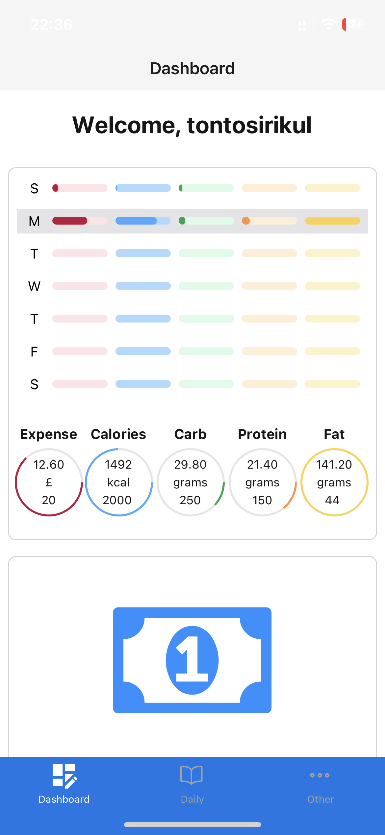
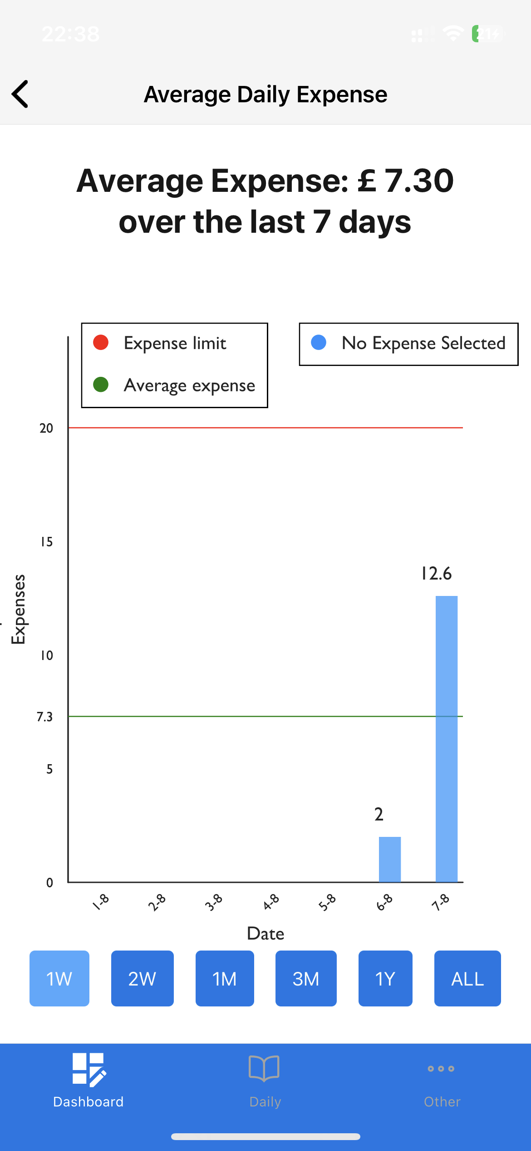
Dashboard and Average Daily Expense Summary

Slide 28
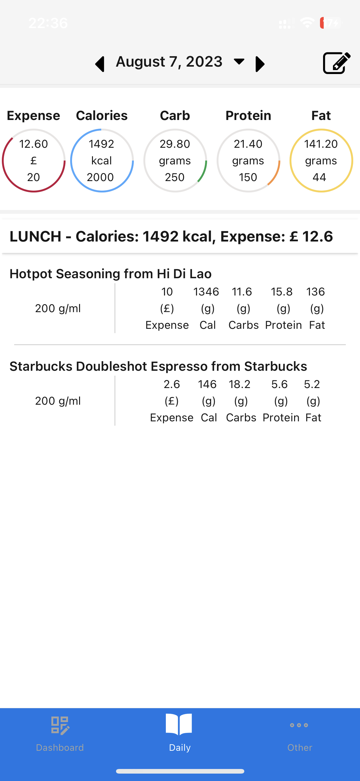
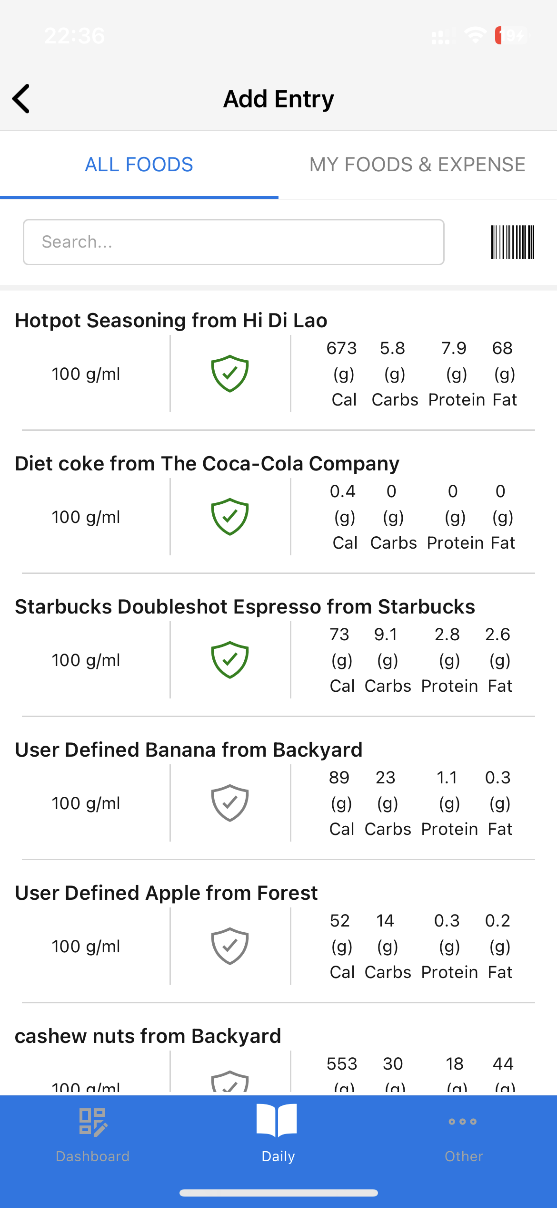
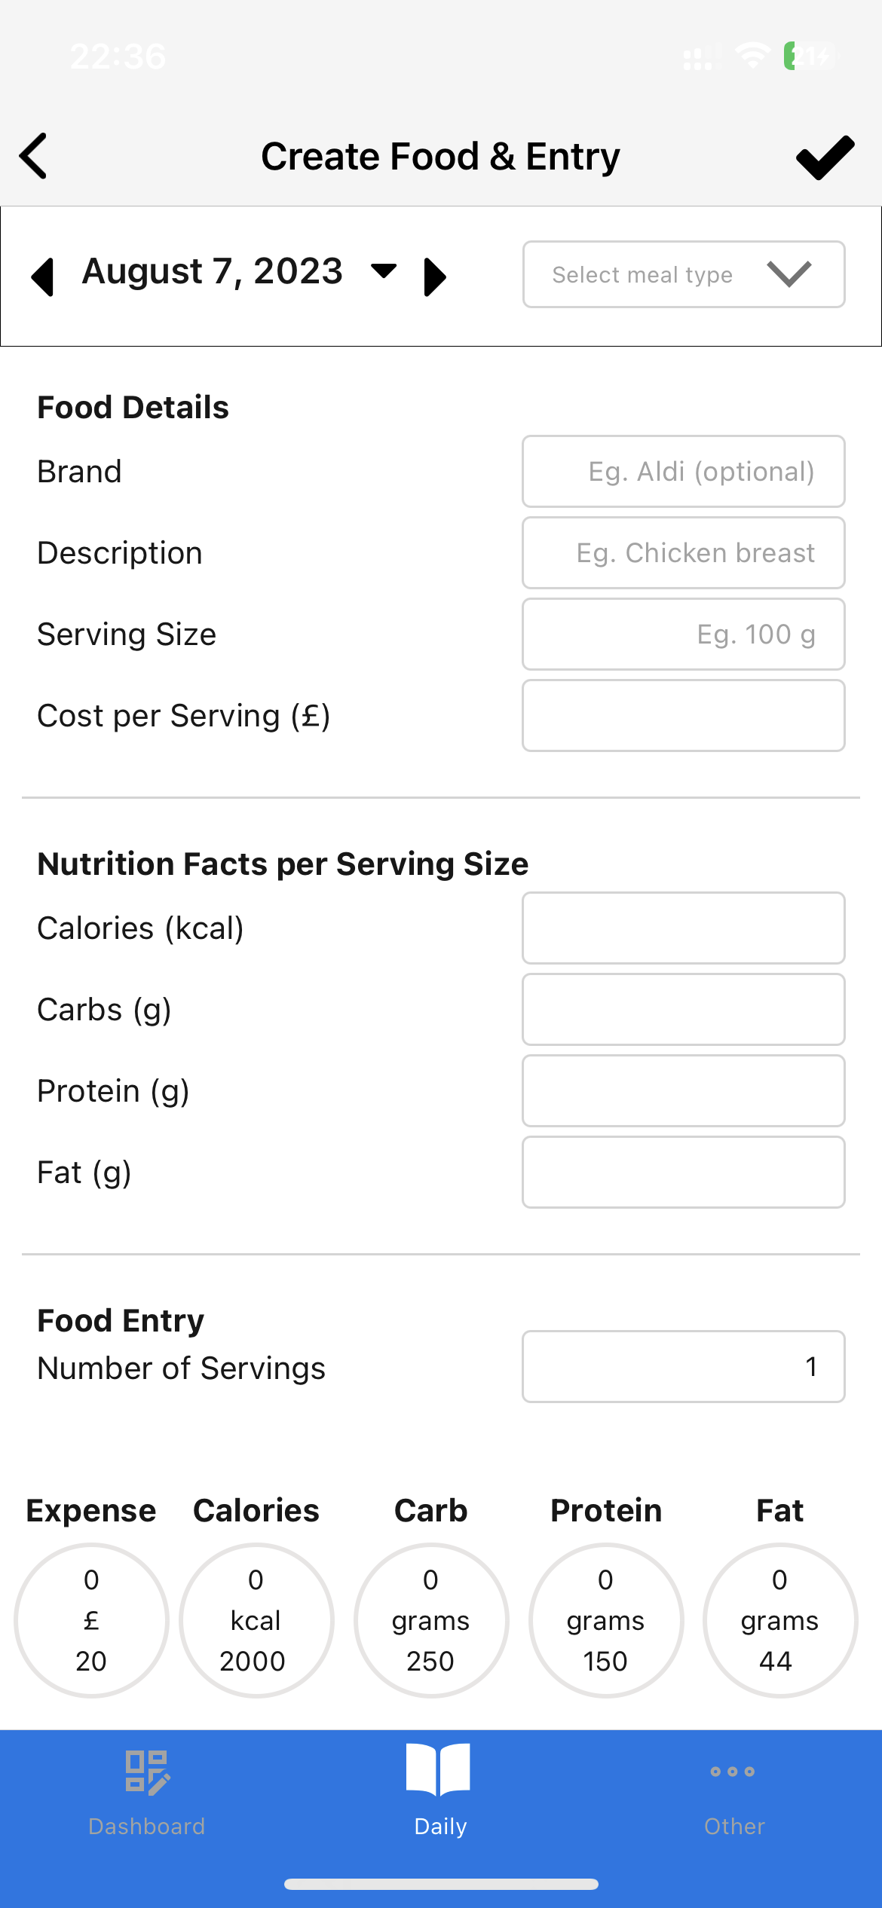
Daily Food Log and Food Logging

Slide 29
Week 8
Key Milestones | Status
Project Topic & High Level scope
Requirements / Analysis
Tools, Stack, Dev. Environment
Prototype and Design
Development
System testing
User Evaluations
Dissertation & Video
Key
Meeting Agenda (if scheduled for this week)
Completed
 | Not Started
 | On track
 | Issues
 | Major issues
 | Completed
Completed
Completed
Completed
Completed Activities This week
Build Barcode scanner Build average expense summary dashboard Provided Backend endpoint unit testing
Upcoming Activities – Next week
Plan on User Acceptance Testing Continue to work on Chapter 3 implementation
In progress / first draft
Completed
Issues, Risks and Concerns

Slide 30
Week 9
Key Milestones | Status
Project Topic & High Level scope
Requirements / Analysis
Tools, Stack, Dev. Environment
Prototype and Design
Development
System testing
User Evaluations
Dissertation & Video
Key
Meeting Agenda (if scheduled for this week)
Demonstrate the prototype and consult on User acceptance testing
Completed
 | Not Started
 | On track
 | Issues
 | Major issues
 | Completed
Completed
Completed
Completed
Completed Activities This week
Finish draft of chapter 4 Finish draft of testing
Upcoming Activities – Next week
Get the user evaluation
Completed
Completed
Issues, Risks and Concerns

Slide 31
Week 10/11 Status Update
The only task besides writing the dissertation and video demonstration is getting the user requirement. However, designing an appropriate questionnaire using a Likert method took a whole week. Moreover, week ten is between travelling back and departure from the accommodation. Therefore, the user evaluation may finish around the start of week 11.
In summary, If the user evaluation is collected, the progress is on track, and I can focus on the written dissertation and making the video.

Slide 32
Week 10
Key Milestones | Status
Project Topic & High Level scope
Requirements / Analysis
Tools, Stack, Dev. Environment
Prototype and Design
Development
System testing
User Evaluations
Dissertation & Video
Key
Meeting Agenda (if scheduled for this week)
Completed
 | Not Started
 | On track
 | Issues
 | Major issues
 | Completed
Completed
Completed
Completed
Completed Activities This week
5 of user evaluations are collected Finish draft of user evaluation methodology Fixed unseen bugs from evaluation
Upcoming Activities – Next week
Writing user evaluation part Making video script
Completed
Completed
Issues, Risks and Concerns

Slide 33
Week 11
Key Milestones | Status
Project Topic & High Level scope
Requirements / Analysis
Tools, Stack, Dev. Environment
Prototype and Design
Development
System testing
User Evaluations
Dissertation & Video
Key
Meeting Agenda (if scheduled for this week)
Evaluation and video discussion
Completed
 | Not Started
 | On track
 | Issues
 | Major issues
 | Completed
Completed
Completed
Completed
Completed Activities This week
Writing testing section 5 of user evaluations are collected Making video script
Upcoming Activities – Next week
Writing evaluation and chapter 5 Making a revision and video
Completed
Completed
Issues, Risks and Concerns

Slide 34
Week 12 - Final Week
Key Milestones | Status
Project Topic & High Level scope
Requirements / Analysis
Tools, Stack, Dev. Environment
Prototype and Design
Development
System testing
User Evaluations
Dissertation & Video
Key
Meeting Agenda (if scheduled for this week)
Completed
 | Not Started
 | On track
 | Issues
 | Major issues
 | Completed
Completed
Completed
Completed
Completed Activities This week
Finished video Revision on dissertation Submitted project
Upcoming Activities Remaining
Completed
Completed
Issues, Risks and Concerns
Completed
Completed

